Slide 1
DUNE DM paper update
Eric
6-Feb-2020
13-Feb updates in red
19-Feb updates start pg 14
3-Mar Orange
13,28-Mar Orange
Notes:
About the Image: A Glass From the Past
While taking a closer look at ancient glass to better understand how it changed over time, Pacific Northwest National Laboratory scientists made an unexpected discovery-the remains of bacteria that once lived on the surface. PNNL researchers and collaborators are delving into the past to further their knowledge about the stability of glass that will be used to safely store low-activity nuclear waste at the Hanford Site. With support from the Department of Energy's Office of Environmental Management, International Programs through the Office of River Protection, they are analyzing this glass found in Swedish hillforts that predates the Vikings because it has a chemical composition similar to what will be produced at Hanford's Waste Treatment and Vitrification Plant and has been "stored" in a known environment for more than 1,500 years.
Research team: David Peeler, Bruce W. Arey, Carolyn I. Pearce, Tamas Varga, Micah D. Miller, Michele Conroy and Michael J. Schweiger (all of PNNL); John S. McCloy (Washington State University); Jamie L. Weaver (National Institute of Standards and Technology); Edward Vicenzi and Thomas Lam (Smithsonian Institution's Museum Conservation Institute); Rolf Sjoblom (Tekedo AB); Eva Hjarthner-Holdar and Erik Ogenhall (Arkeologerna); and Albert A. Kruger (Department of Energy Office of River Protection). The image was colorized by Nathan Johnson (PNNL).
Instrument: Scanning electron microscope and focus ion beam hybrid
https://www.flickr.com/photos/pnnl/24220123368/in/photolist-fqwiqF-aBF44N-fqwj9R-aEuQHd-CUfsRW-pZVLNL-aPjNkZ-fxBosi-aErWsK-aBCnZk-ECMqka-aEr4hT-6yL625-6xvZrp-6xh38v-6xmeiY-VNqjUa-CJUXKp-CPUyAo-25kubq5-BUPMLB-211nysv-Chikdn-Cq6fRm-BscBWe-CnhkRJ-CiHawx-CPUwEu-BUGK7J-CiHawn-BUPKMg-CGEBLY-BUGHTw-CJV1jx-CPUxnw-CSdgpF-CSdj4D-CJUWi6-CPUwFm-BXsubh-CPUxJd-CiHdVB-BUGG5b-BUGHYm-22DixCm-243ex8R-Cq6jHQ-CGEzzy-PEd3HJ-P9S5sd

Slide 2
At last meeting 31-Jan-2020, it was decided/learned:
We still need Richard’s plot on PSD simulation
need refined text (plot?) from Chris about the toy MC conjecture for light collection w dense packed 8x22m^2 and WLS foils on an acrylic border around 6x6x20 m^3 box
I would do the following, after agreeing that an inner 30-50cm polyethylene liner inside cryostat might not be reasonable.
I would run n’s from outside the DUNE-like wood+foam+coldcryoskin wall
We will use Li’s/Beacom’s Figure to show how much water shielding bricks are needed outside
I would run n’s from that coldcryoskin wall too
…there’s nothing in the DUNE DP bulk LAr
Per email from Jose Alfonso Soto Oton
I was seeing “LogicalVolumes” not field cage tubes in the G4 DuneDP drawing

Slide 3
n normalization awareness
In the meantime, I’ve also been running n’s from concrete in DUNE full geom
On the other wp
In so doing, I realize I’ve been normalizing to 10 Hz emanating from rock, not 10 Hz n-capture rate in the LAr, which is the right normalization!
From the full DUNE sim it’s clear to get the 10 Hz capture rate in the LAr, one needs about 20kHz emanating from the rock.
In the full sim that’s what I see
20kHz follows from 6.5 muBq/cm3 in the rock
It also gives a flux from the wall of 0.91E-5/cm^2/sec, as is claimed to be measured at SURF
This is the rate with which to normalize properly
In the following plots you’ll see we need 40 only 20 cm of Li-Beacom water bricks to just get by inside a 10cm acrylic box with O(100) n bkgd even after multiple site cuts at a 100 keV threshold
Sensitivity curves currently show 100 keV with 10 bkgd
Would it kill us to have a 15-20cm thick acrylic box?

Slide 4
I think we need to fix a geometry for the paper.
We this, we can then say how well we’re doing with well-studied geometry and bkgds,
And with further embellishments/tweaks – perhaps not precisely specified – we can get to an O(1) bkgd at 75 keV and O(10) bkgd at 50 keV ….
Basically more plastic everywhere.
So, for that geometry, I propose that we say we have the 40 20 cm water bricks among the I-beams, along with the wood-foam-coldcryoskin wall, and a 10+cm acrylic box inside
This is all consistent with what I’ve modeled
Except not considering the neutrons from the I-beams themselves
Alternatively 50cm water, 10cm acrylic
New, tall inner acrylic box.

Slide 5
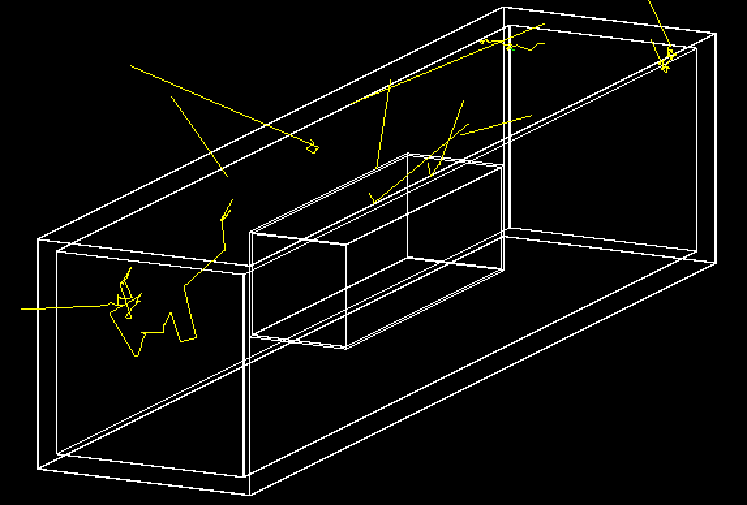
Geometry G4 pic
10 neutrons launched per the rock spectrum (next pg) from top outside the ~80cm foam+wood+cold-cryoskin sandwich.
Inside is the 10cm acrylic box surrounding our fiducial 1 kt on the walls of which one imagines WLS foils
See next page

Slide 6
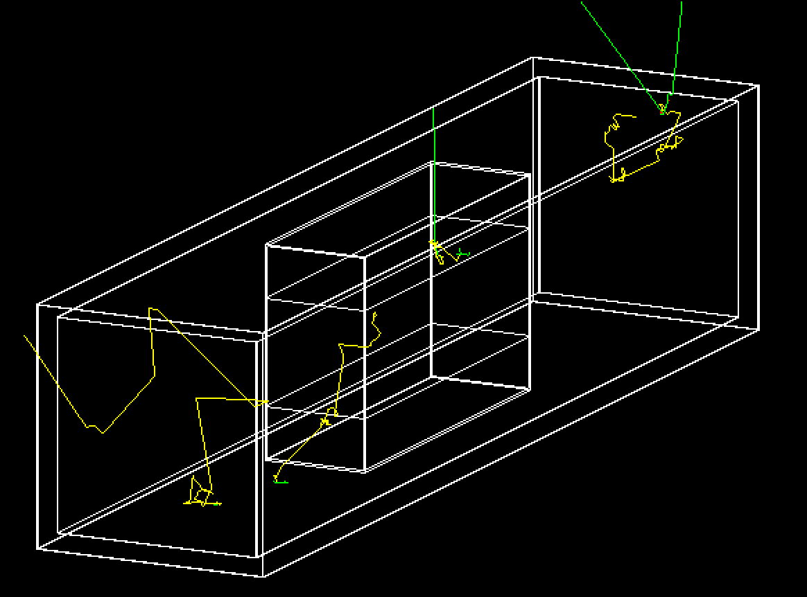
13-Feb-2019: new tall box.
Neutrons now emanated uniformly from the inner surrounding6-sided coldCryoSkin, not from a plane, and multiplied by (4+2*r).

Slide 7
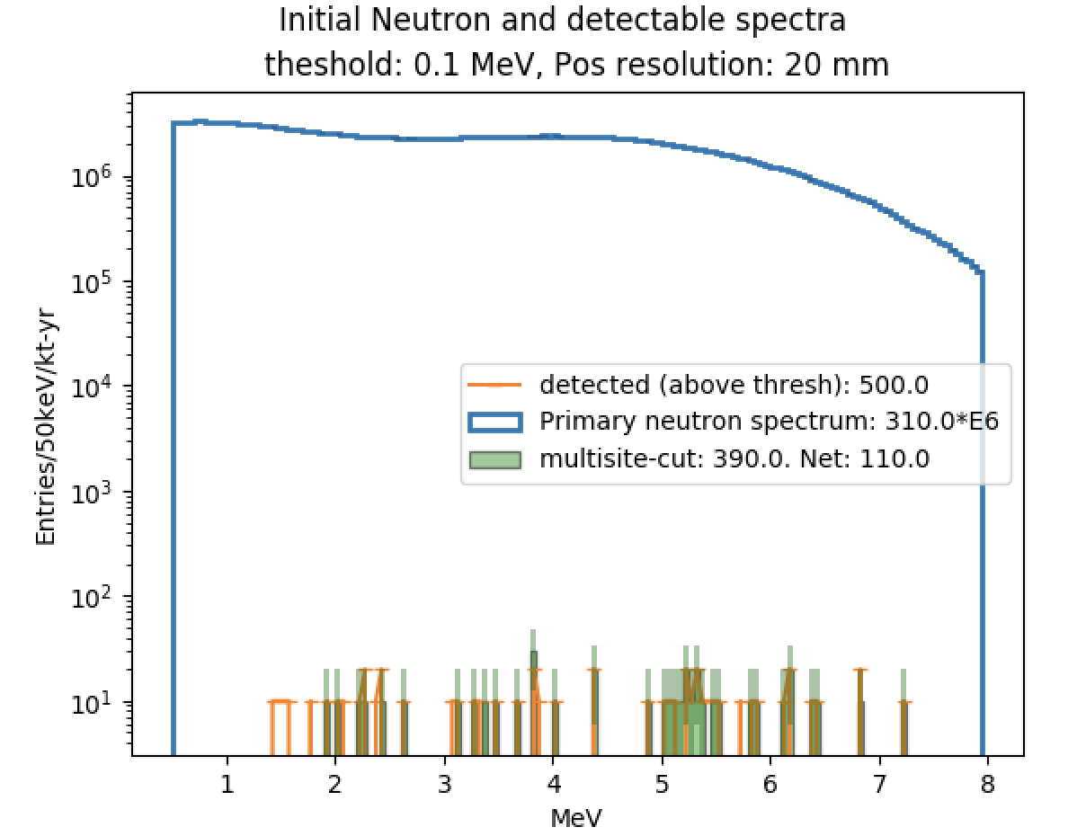
n flux in our 1kt from outside rock in LAr

Slide 8
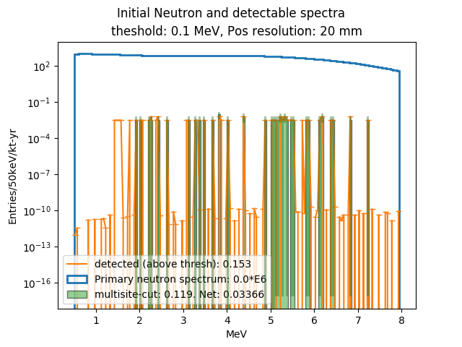
13-Feb-2019 update to previous using 0.9E-5 /cm2/sec n emanation from walls.

Slide 9
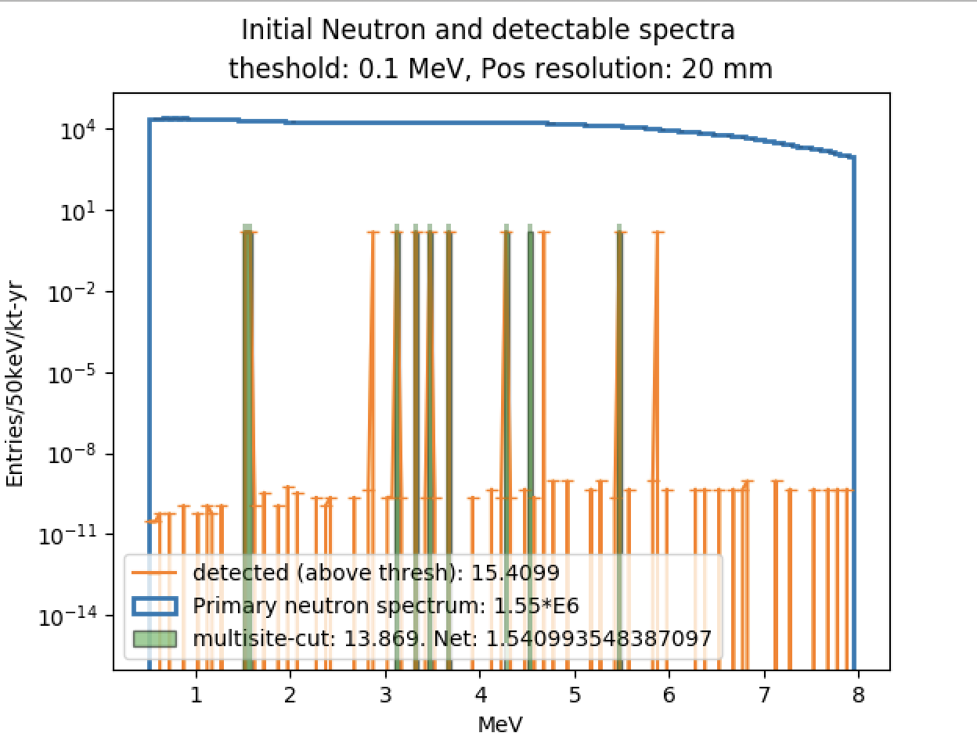
n flux in our 1kt for U+Th coldcryoskin
Per Richard, from https://www.sciencedirect.com/science/article/pii/S0168900208009984:
“The neutron yields for 1 ppb of U and 1 ppb of Th are 1.47E-10 n/s/cm3 and 4.74E-11 n/s/cm3”
Not really sure I understand this low-level grass of very low-weighted events….
But you can see 12 evts pass the cut, 9 of which are tagged as multi-site
I used same n spectrum as for rock neutrons.
Chris says it should be 269+/-169 U238 and 19.7 Th232 ppb.
So 457E-10 n/cm3/sec
I used
20E-10 n/cm3/sec
23x too low
So 35 n’s/year

Slide 10
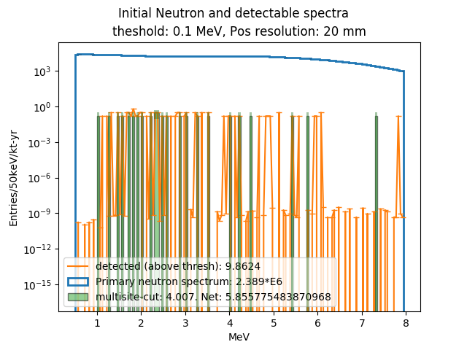
13-Feb 20cm thick Acrylic
This 5.8 makes some sense. I used 20E-10 n/cm3/sec, and cryoskin is 1cm thick. So This is 2E-9 /cm2/sec, very comparable to the neutron flux coming from walls, but here we don’t have benefit of 20cm water. Which would give a x100 reduction, ~0.05 which is quite close to what I got for neutrons from rock. (Presuming our acrylic is not helping much.)

Slide 11
Darkside 20k paper
https://arxiv.org/pdf/1707.08145.pdf
Lots of Rn scenarios carefully considered
Clearly we must say something about this, even if we don’t simulate anything

Slide 12
Notes from 6-Feb meeting itself
Acrylic box must be a tall box with top/bottom inside ss cryoskin but outside light detection.
So as not to interfere with E field and charge drift
This means in G4 my symmetry is lost that has allowed for launching ns just from ceiling.
I need to try to put in this acrylic box and launch n’s from the coldcryoskin Volume. This can be a G4 nightmare … I will give it half a day and try. This is now done.
Also it is thought DEAP’s acrylic is 5cm, so already hard to argue we should go thicker, though
I should launch n’s from some cryoskin as I have it for a thinner and a thicker acrylic, just to see the effect: 5cm, 15cm, 20 cm. Done for low, hi, hi stats, resp
We will declare we need 3-10x cleaner ss and this 10cm of acrylic, most likely
And, from Beacom, we need 60 20 cm of Water to get the outside n’s reduced another 2 orders of mag

Slide 13
13-Feb mtg notes
Chris shows needed SiPM packing floor and/or ceiling to get nph/100keV threshold. Presuming wls foils on acrylic walls, ….
Will perhaps add some PMT lines to this plot
Will explain his toy MC in text,
Will have a stab at a better n/gamma bkgd table than is currently in
Eric: Acrylic should lose the roof and floor. Should also be bumped out a meter in all directions.
Also, try to go back to DEEP’s 5cm thick Acrylic, since it is not buying us too much.
Do boe calc for n’s arriving inside fv. Done, sorta.
Will address the text, currently full of all kinds of geometry mishmash description
Richard will get Gabe to do a solid works design that looks something like the TDR image of DUNE DP, with tiled SiPMs floor and roof. Hopefully, cryoskin + wood + foam.
Will add F90 plot. Might also run a longer sim.

Slide 14
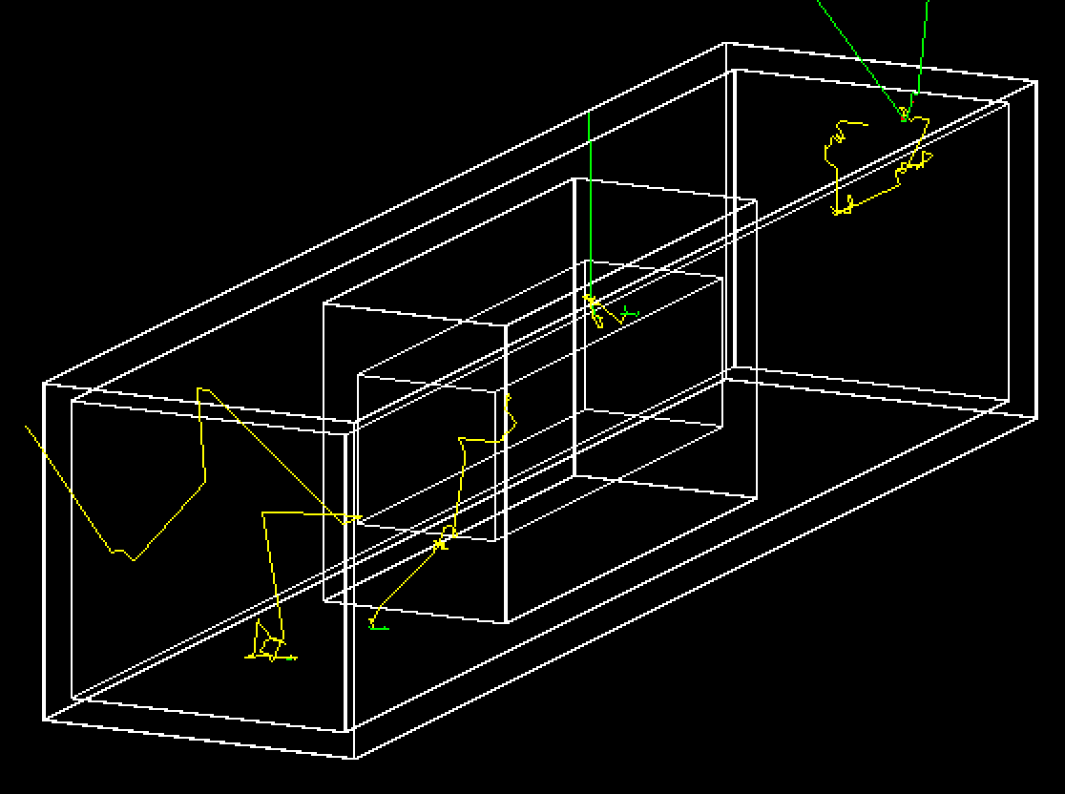
13-Feb post-mtg

Slide 15
Meeting, 19-Feb-2019
Acrylic is now 5cm thick, ala DEEP, not 10cm
Acrylic box as no ceiling/floor
Bumped out 1m on all sides: 8x12x22 m3 box
Fixed bug in over-subtracting one or two events in which a n gamma capture happened w no n.r. in fidvolume
Made plots to clip off rounding error 0 entries, fix over-subtraction bug
cold cryoSkin n count went up a little in fid volume: ~ 7.8 evts after multisite tag
0.53 evts from rock muons
Made xy,yz,xz n plots – point of n emanation in cryo skin (next)
Now, use to reweigh cryoskin and give contribution from SiPMs/camera
Made all my text changes to Overleaf paper. Still some obvi things needing doing, wrt text, beautifying plot, omitting one plot, table fix, text, refs
I note there is ~ 2.5 k$ left on our wp.

Slide 16
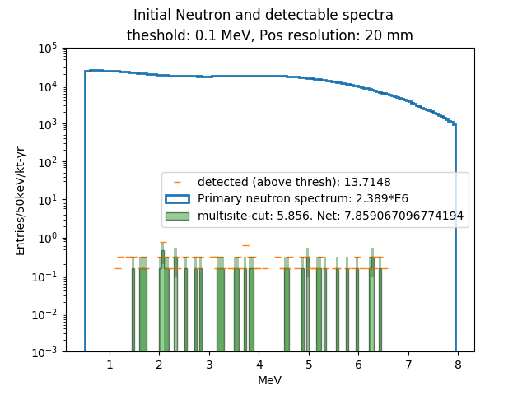
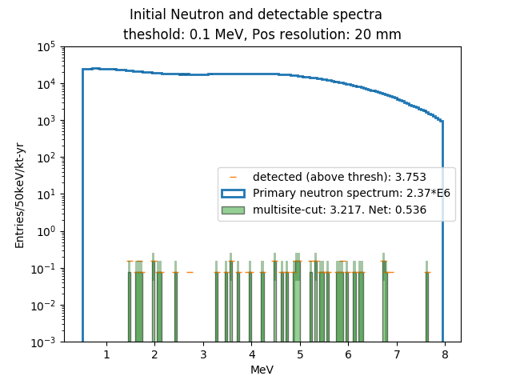
Cryoskin (left), Rock (right)

Slide 17
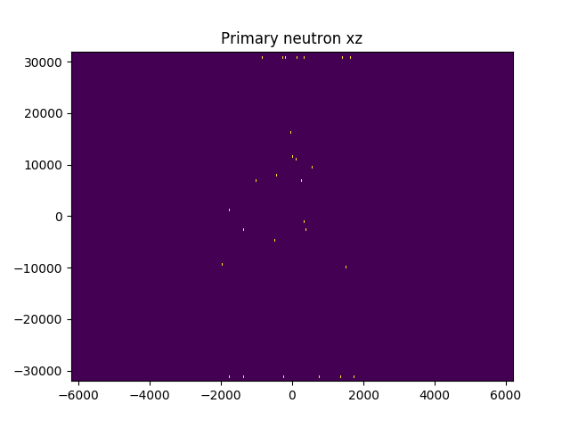
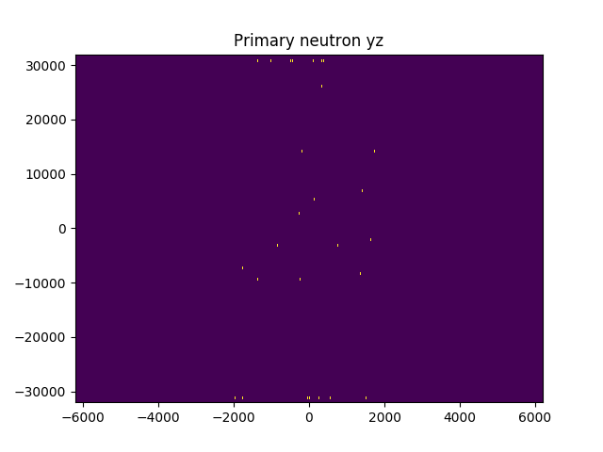
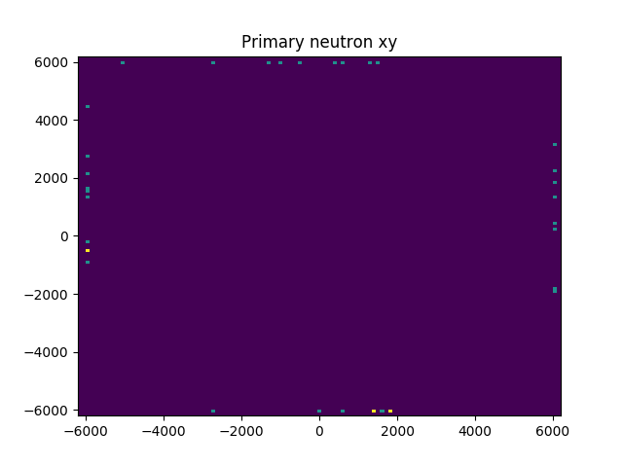
Cryoskin n point of emanation which give bkgd
The xz, yz plots are wrong: axes are flipped. I learn after meeting
I need to imshow plot the transpose of histo2d.

Slide 18
(post)Meeting , 19-Feb-2019
Chris wonders why our fidv doesn’t have walls equal distance away on all sides
Eric can run this long, skinny geometry
Richard will get LZ paper to show neutron rate from its SiPMs
No one is sure why the xy,yz,xz histo2Ds are inconsistent.
Fixed a weirdness of matplotlib’s imshow, which requires plotting the histo2D transpose.
Conclusion: indeed no evts come from endcaps. Everything comes from the x,y walls around the fv.

Slide 19
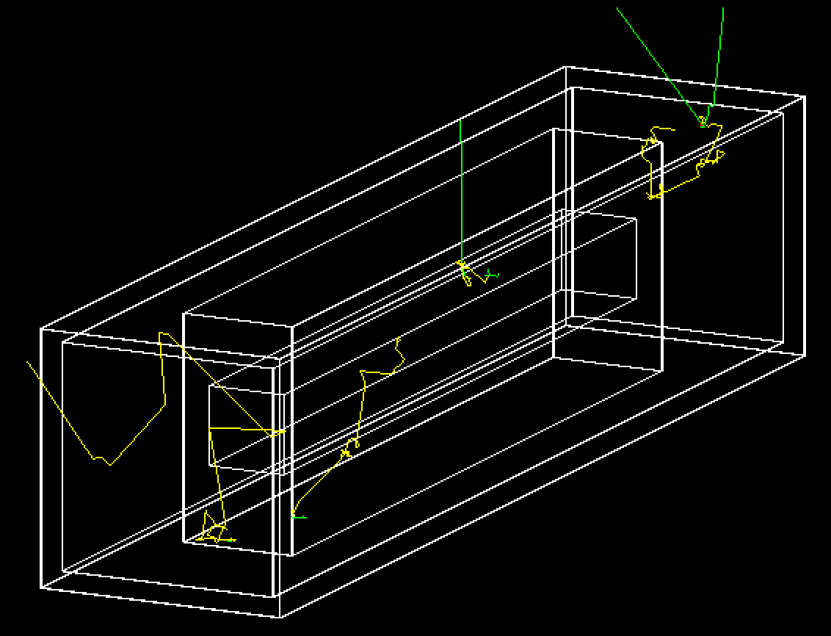
New long-skinny geometry: 4.2x4.2x40 m^3

Slide 20
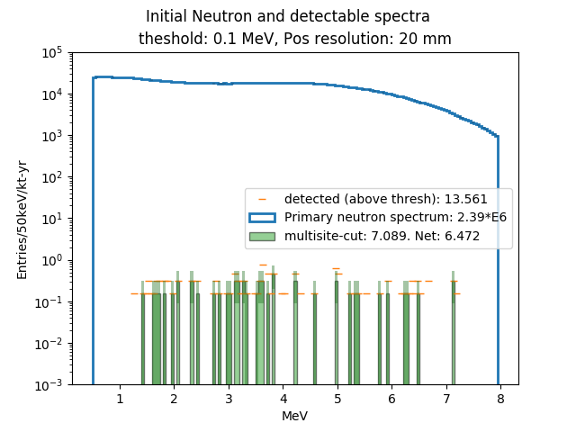
Long skinny fidv has a marginally smaller n count from cold cryo skin.
Compare to upper left, slide 16.
Post-tag: 6.47 vs 7.85
(Each evt has a weight of about 0.4, so raw pre-tag numbers 13.561/0.4 and 13.71/0.4, have stat errors well within 1 sigma of each other.)

Slide 21
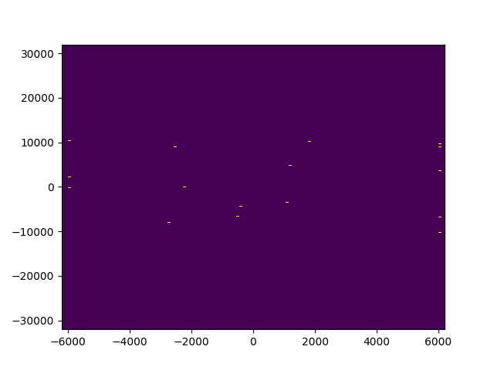
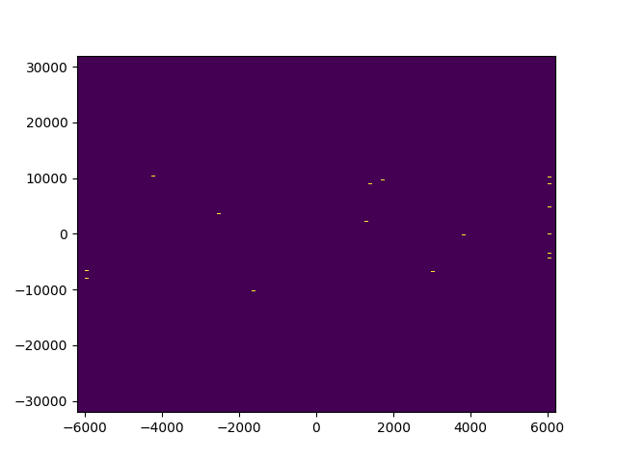
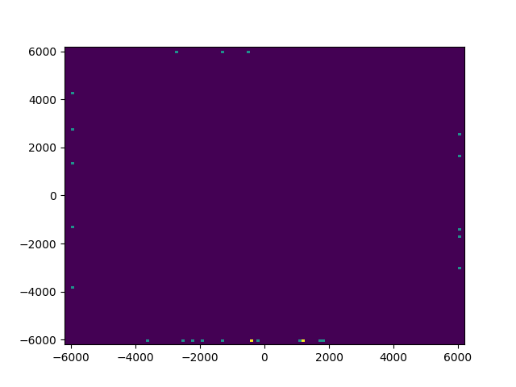
Fixed histo2d’s of location of n’s cryoskin point of origin, which produce the bkgd events in fidv
zx
zy
xy

Slide 22
3-Mar-2020 Meeting
Checks against Darkside20k from RS’s tables
Post-mtg emails: we see consistency achieved
Their n’s are 2-4 orders of mag smaller than my 20E-10 n/cm3/sec
They have 40x less steel
Yet they only have 2400 emanating in 1 kt-yr
I have ~3E6
So they must use 1E-10 n/cm3/sec for consistency, not smaller.
Discussion of late time from large volume reflections and compromising F90
Chris will consider putting it in … somehow
Gabe will talk to me about producing a DUNE DP-ish drawing

Slide 23
13-Mar-2020 – “last mtg”
DUNE Drawing – Gabe 3 hrs
Go to long, skinny, add fidV, more I-beams/water, just one pic, 24x24cm2 tiles, more back walls, different colors,
New n spectrum from Chris Neut-bot or Vitaly – Eric 2 hrs
No n-plot, but long MC run n count vs thickness. baseline is DS20k n SS rate
General editing: Radon discussion, DUNE agnostic language – Chris J 2 hrs
Optical MC explanation, consistency with Richard’s PSD – Chris J 2 hrs
PSD optical sim words and plot – done
Complete Background table – Richard/Chris. 2 hrs + 2 hrs
Particular connection to Darkside20k reference
Sensitivities at agreed-upon bkgds/thresholds – Eric 2 hrs
Meeting today 4 hrs
Ben Loer Reading 2 hrs.
Whence, to DUNE paper committee as advance notice.
Submission arXiv/JINST,EPJC by ~27-Mar – Eric 3 hrs

Slide 24
28-Mar discussion
Recap of Krudyatsev’s paper as on Richard’s slides:
U/Th, 2.8,0.8 mBq/kg in DS20k
1.5/0.8 mBq/kg for LZ
3320/80 mBq/kg DUNE
Eric has used DUNE U/144 so far
Eric will now use 2:1 ratio.
Eric will scan the two spectra and add them 2:1 and run
Eric will make a x:y colz for mid-slice in z and superpose the rectangle that is the fidvolume
Richard will read over text
Shoot for draft to Ben L next wk.

